Slide 1



Slide 2








Logout
€27.80
Insert Money
Check Change
Pay

Slide 3




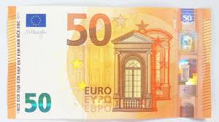

Logout
+

Slide 4


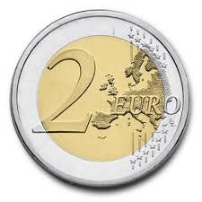
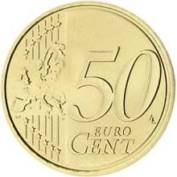
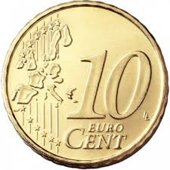
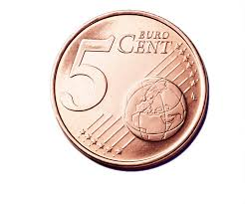



Logout
+
+
+
+
+
Total: 00.00

Slide 5
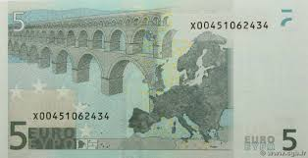
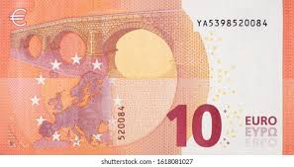
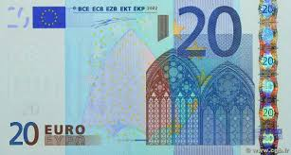

Logout
+
+
+
+
Total: 00.00

Slide 6




Logout
+
+
+
Clear Amount/Reset
X 4
+
Total: 00.00

Slide 7
Logout
+
+
+
+
Add Money?
Total: 00.00

Slide 8
Logout
+
€27.80

Slide 9


Logout
Add Money?
+
€27.80
Do you want to Reset the Wallet?

Slide 10
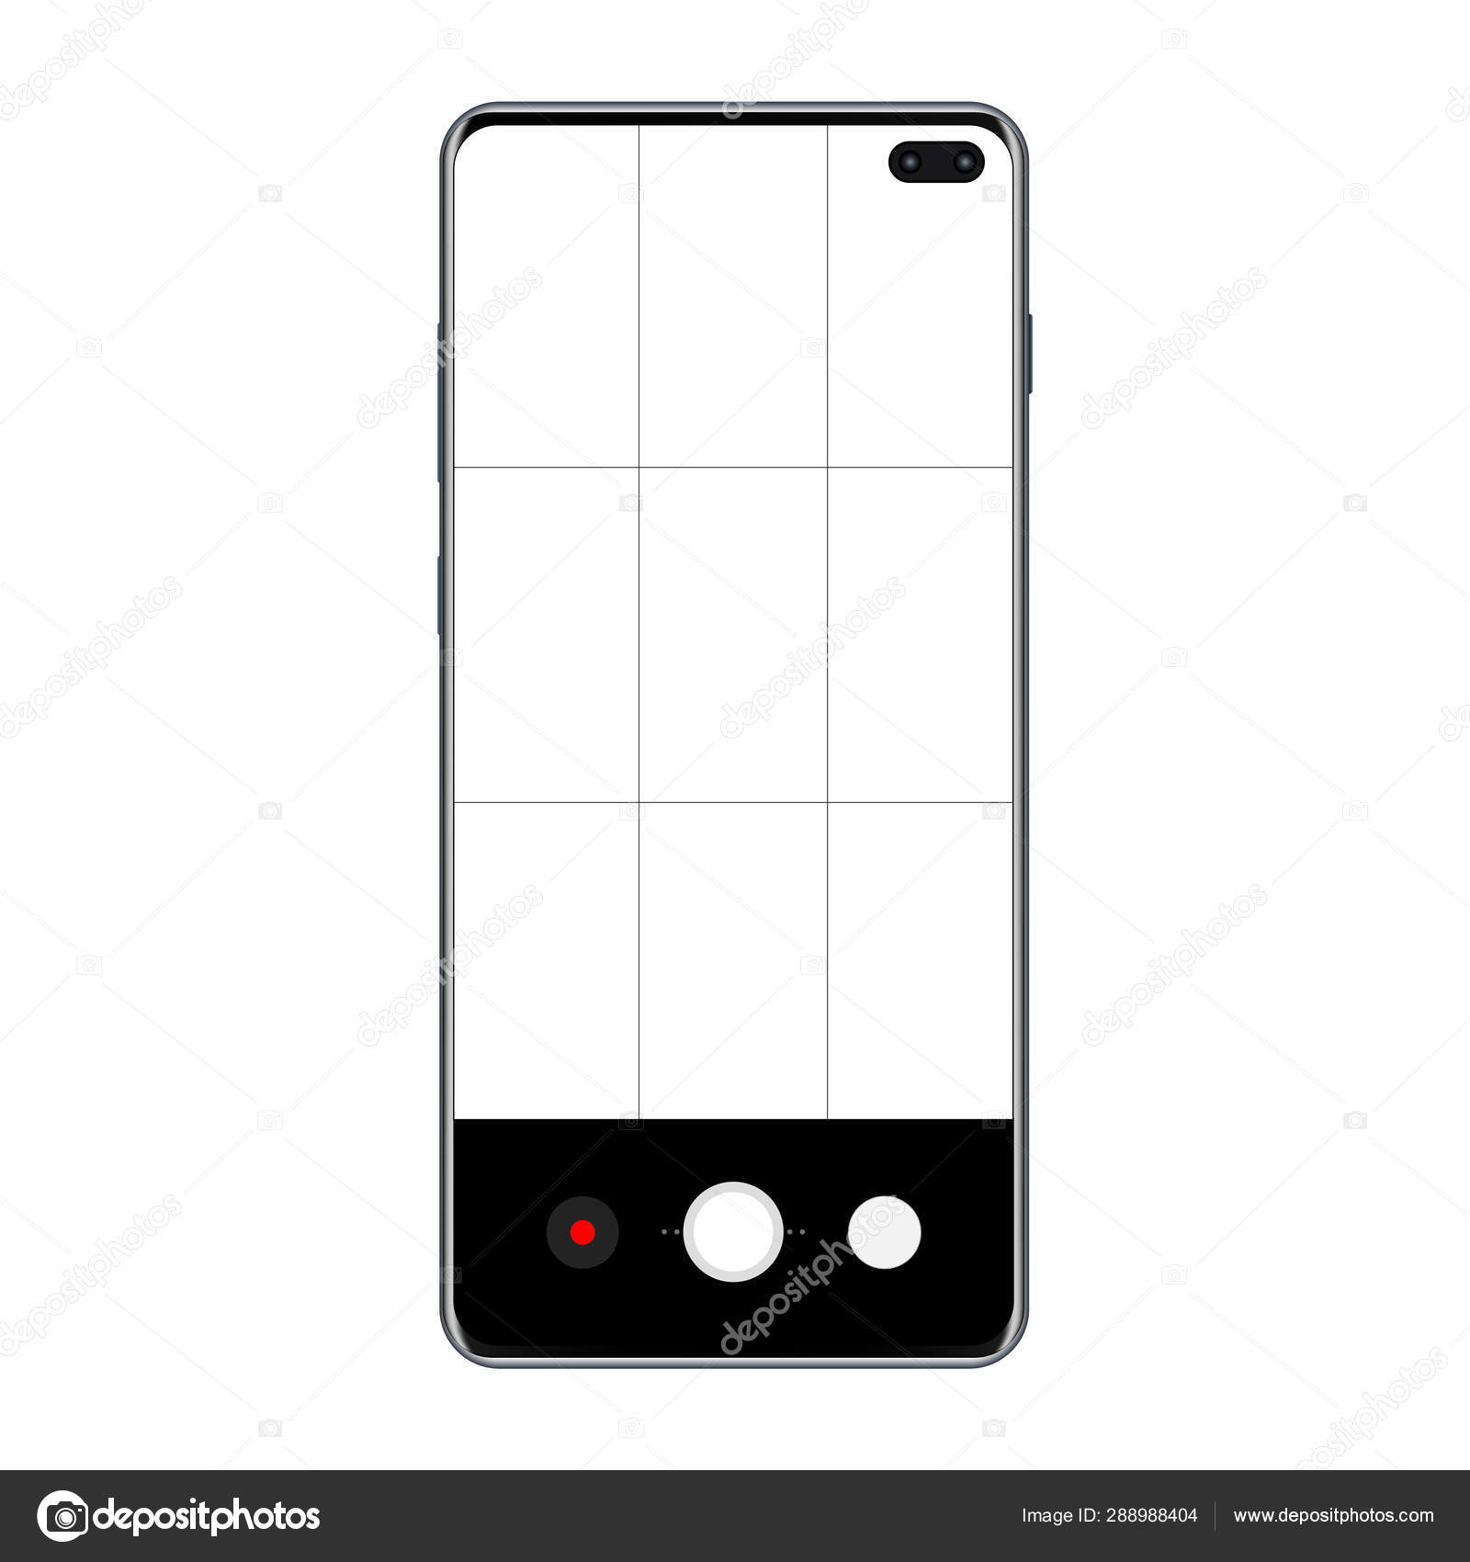
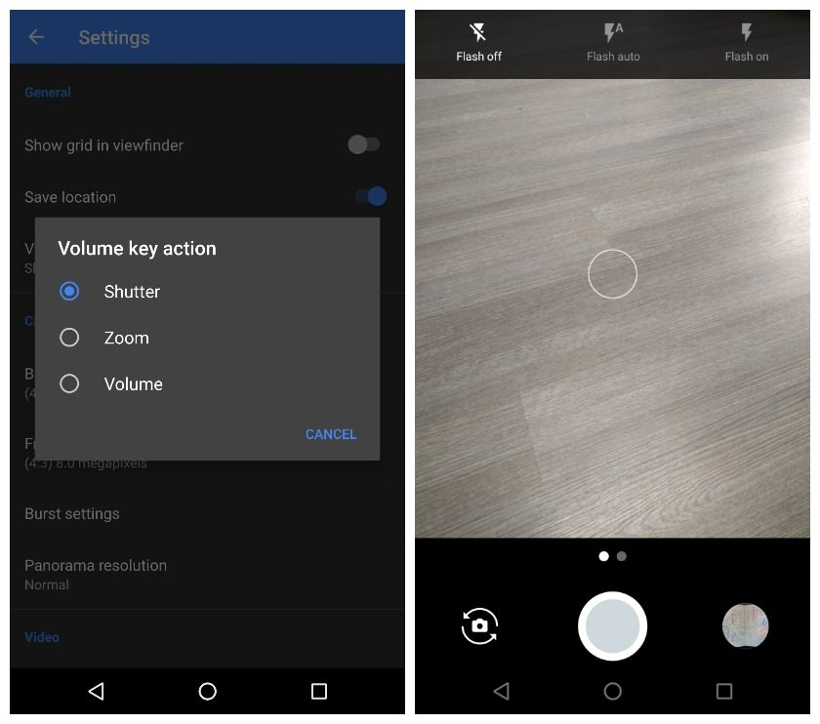

Logout

Slide 11

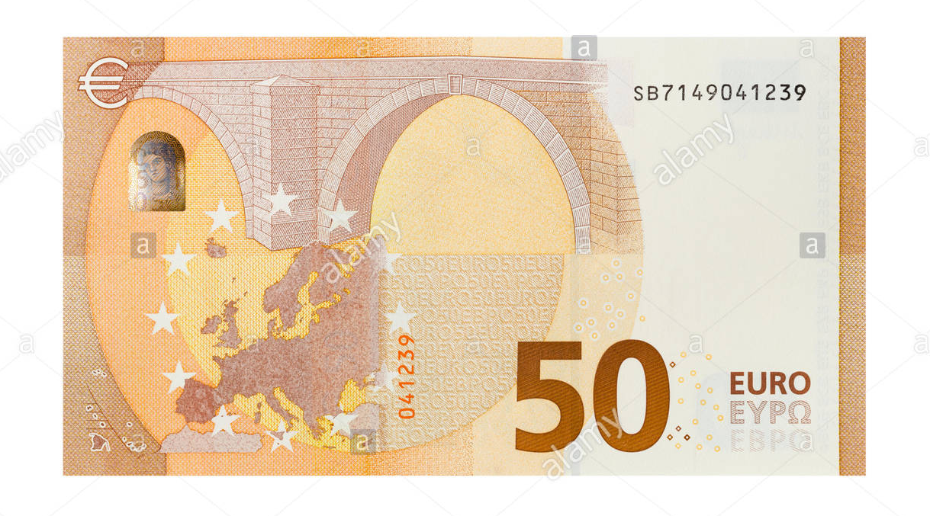


Logout
€50.00
+
Scan

Slide 12
Logout
€50.00
Add Money?
+
Scan

Slide 13




Logout
€0.00
Failed to Scan
Retry?
Scan

Slide 14

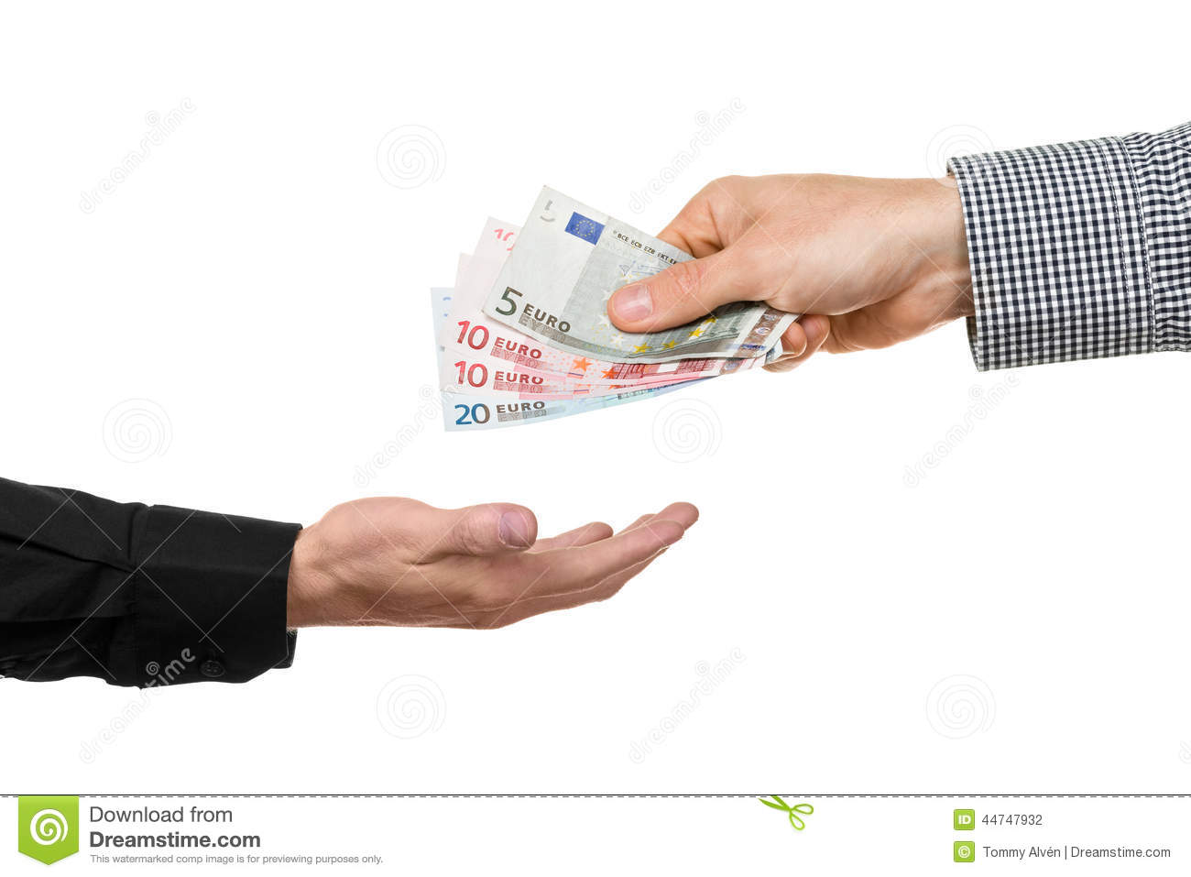

Logout
€50.00
€27.80

Slide 15
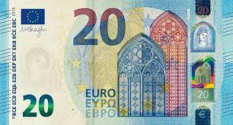
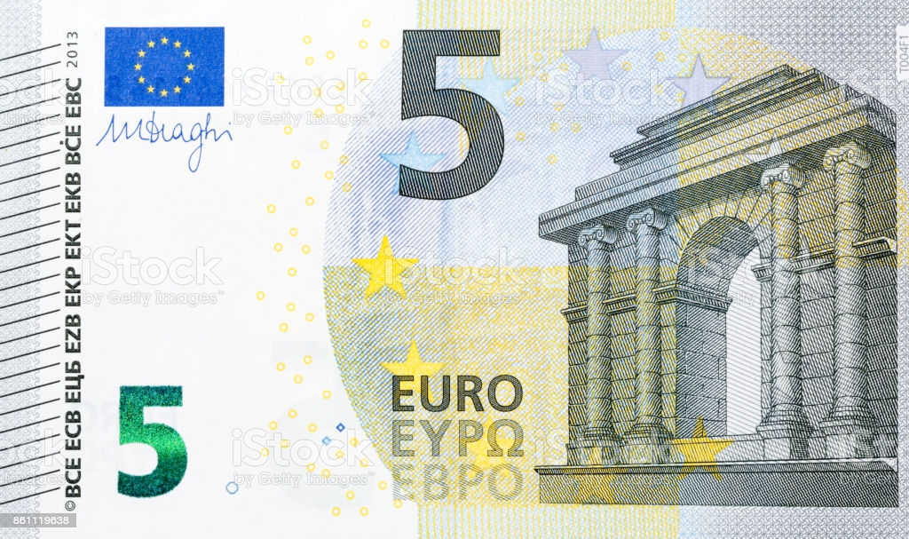

+

Slide 16
Fifty Euros
Two Euros
Twenty Euros
One Euros
Ten Euros
Fifty Cent
Five Euros
Ten Cent

Slide 17
Ten Euros
€0.00

